Slide 1

EUROSENTIMENT
BILLING & STATS Demonstration

Slide 2

Presentation purpose
This presentation aims to show the Billing & Stats features of the EUROSENTIMENT platform.
In the next slides, the following steps are shown:
- A user registers an account as “Service Developer”;
- The new Service Developer registers his own service;
- A user registers an account as “Content Provider”;
- The new Content Provider exploits the service of the previous user to analyse his own texts;
- The Content Provider checks his own statistics and bills;
- The Service Developer checks his own statistics and bills.

Slide 3
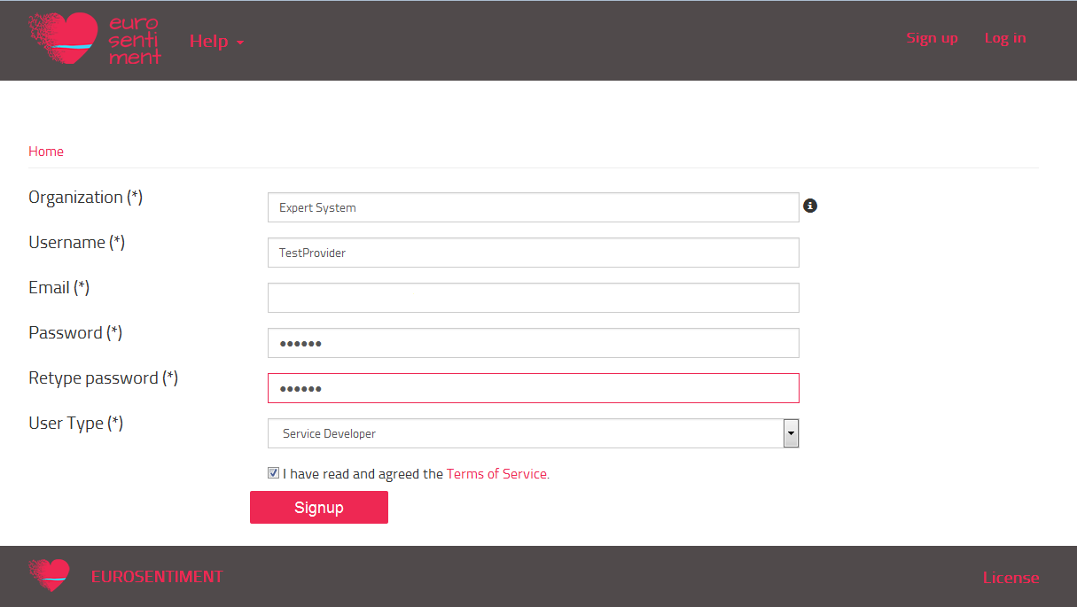
Service Developer Registration
A new user registers an account as “Service Developer”:
The username of this account is “TestProvider” (the e-mail has been omitted).

Slide 4
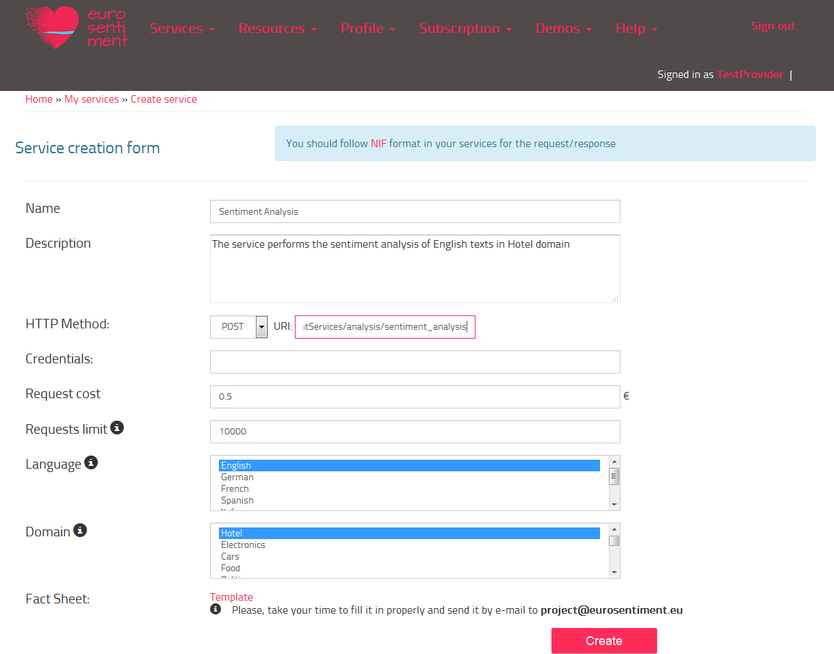
Registration of a new analysis service
The user TestProvider registers a new service that performs the sentiment analysis for English texts in the “Hotel” domain; the following picture shows the registration form:
This new service will be available for every user which is interested in sentiment analysis of English texts in the “Hotel” domain.

Slide 5
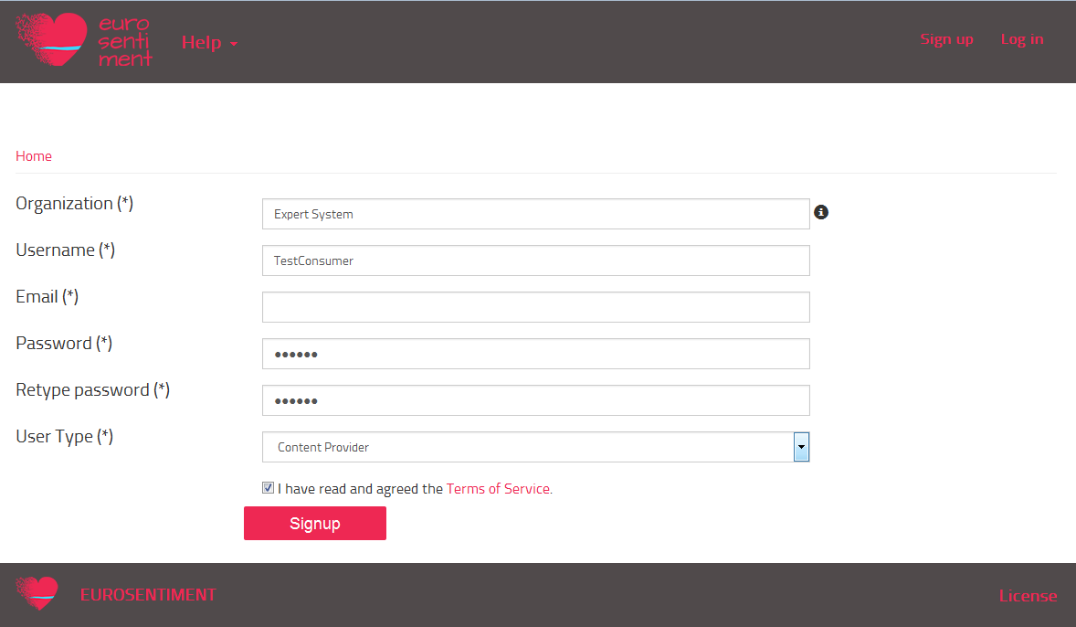
Content Provider Registration
A new user registers an account as “Content Provider”:
The username of this account is “TestConsumer” (the e-mail has been omitted).

Slide 6
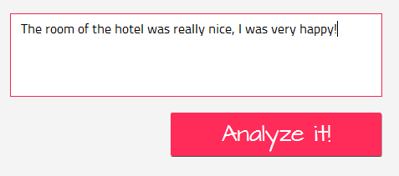
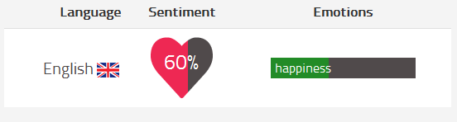
Consuming a service
The user TestConsumer exploits the service owned by the user TestProvider to analyse his texts:
Every operation that the user TestConsumer requires is logged in the Billing & Stats modules; the logs contain the basis data for the calculation of the statistics and bills.

Slide 7
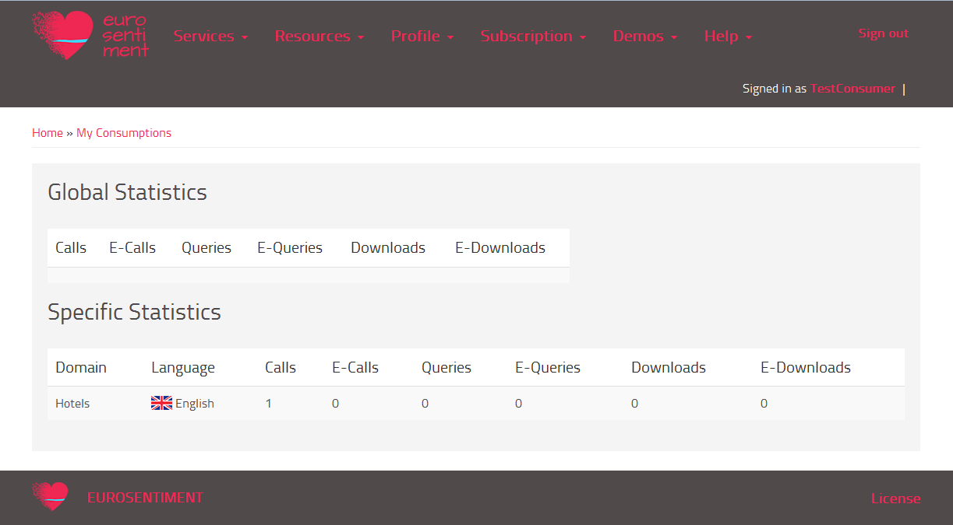
TestConsumer Statistics
In the section “Subscription -> My consumptions” the consumer can see his own statistics:
Every time that a user accesses to a language resource or to an analysis service, the system tracks this access; once a day, the stats module read the logs and calculate the statistics.

Slide 8
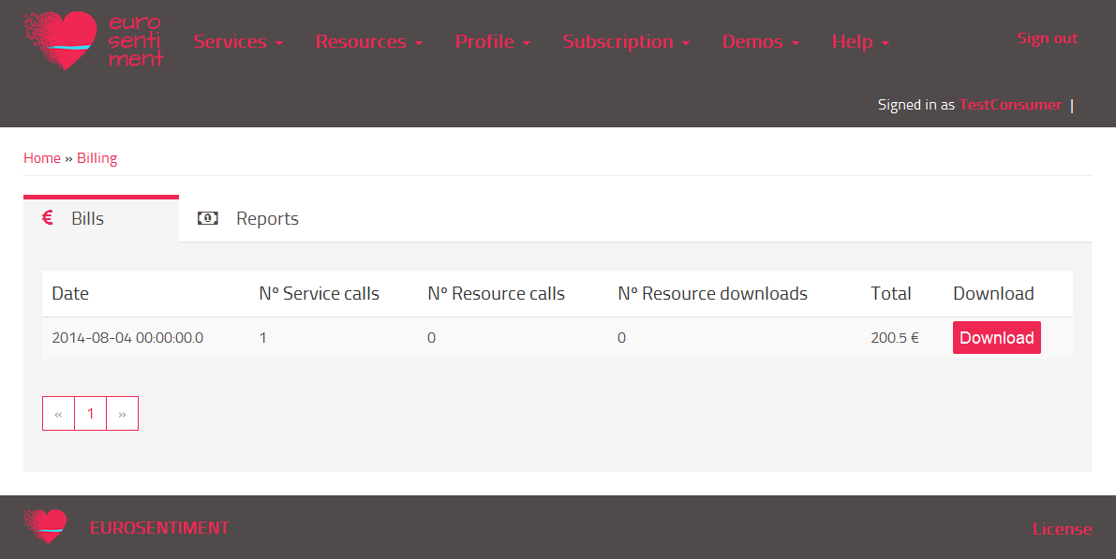
TestConsumer Billing
In the section “Subscription -> Billing” the consumer can see his own bills:
The picture above shows the bills of the user; the tabs allow the user to see his revenue reports too. In this case, the user hasn’t registered any services/resources, so the reports contain “zero” in every field. The total amount of fees is the result of the sum between the subscription fees (200) and the consuming fees (0,5).
The billing module exploits the logs for calculating the bills. The calculation is performed once a month, when the current day is the same of the day of the account registration date: for each account, the billing module calculates a bill and a revenue report.

Slide 9
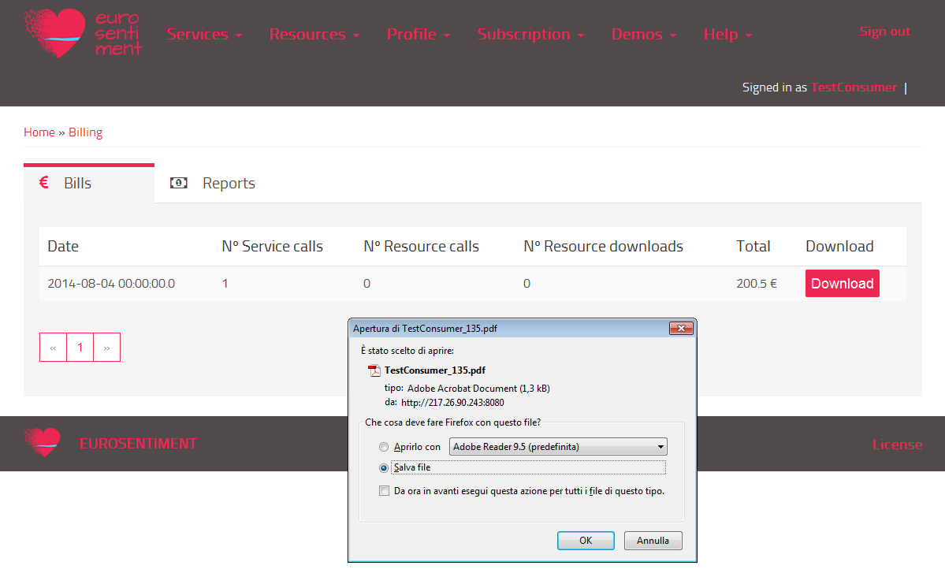
TestConsumer Billing: download
The user can download his bills/reports:
The name of the file is composed in the following way: username_billID.

Slide 10
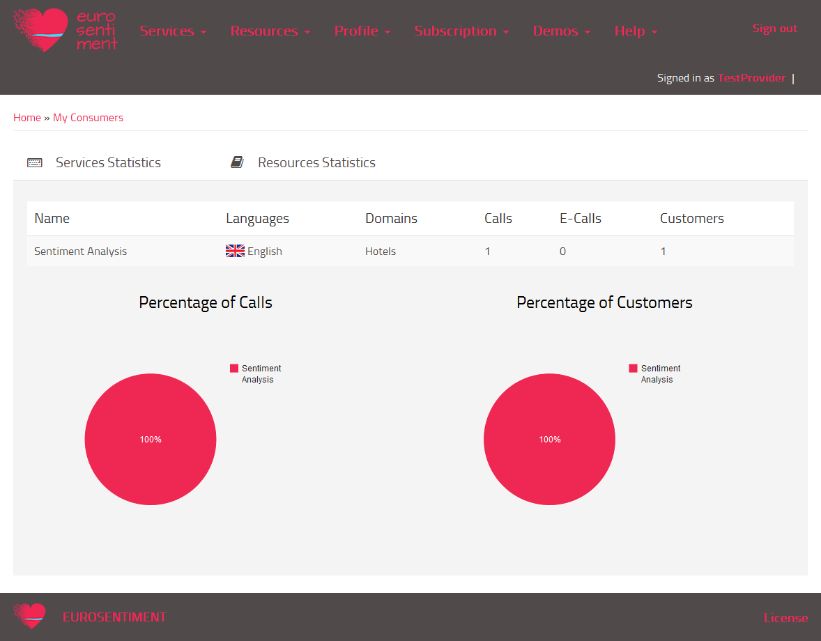
TestProvider Statistics
In the section “Subscription -> My consumers” the provider can see his own statistics:
The statistics are calculated once a day for all the registered users.

Slide 11

TestProvider Billing
In the section “…” the consumer can see his own bills/reports (here the bills are shown):
Note that the total amount is only composed by the subscription fees, because the user hasn’t performed any call or query.
The statistics are calculated once a day for all the registered users.

Slide 12
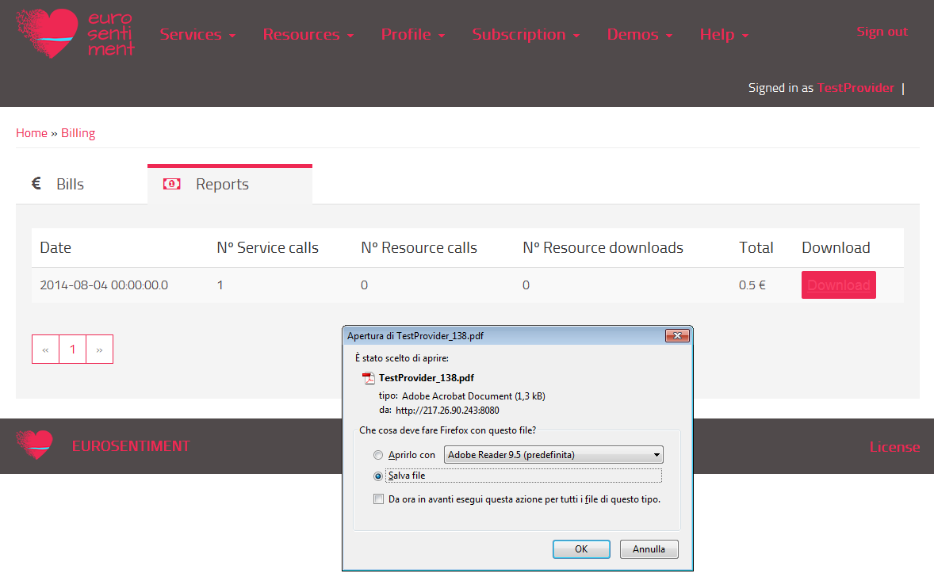
TestProvider Billing (report)
It is interesting to show the revenue report of the TestProvider:
Note that the cost of the single service call was inserted by the owner when he has registered it; the “total” is the revenue of the user.
As for the bills, the reports are downloadable, too.

